Slide 1

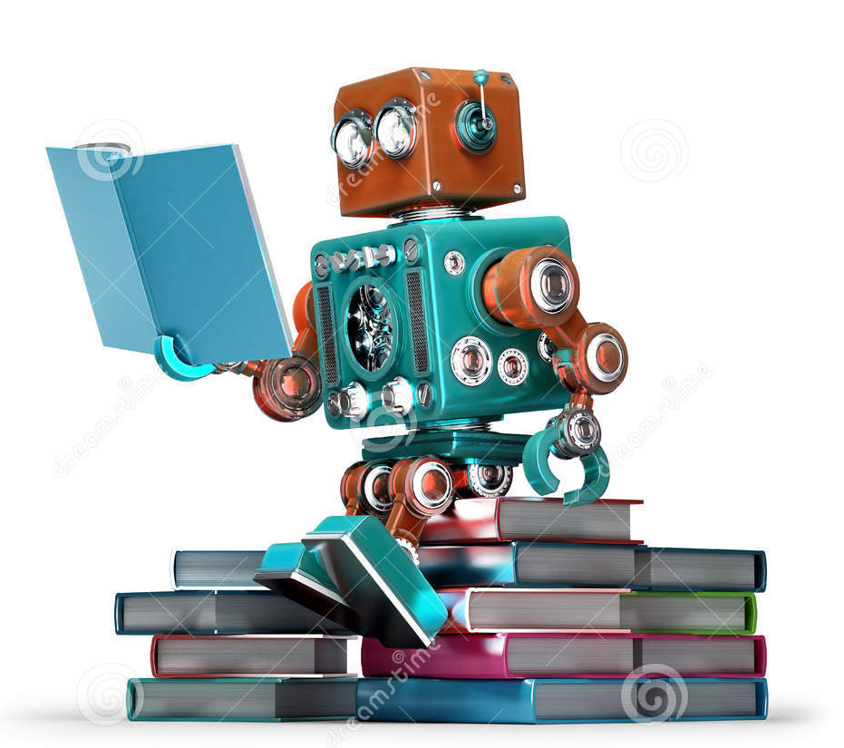
Teaching robots to read text passages
A presentation
by Austin Leo
and Stacia Near

Slide 2
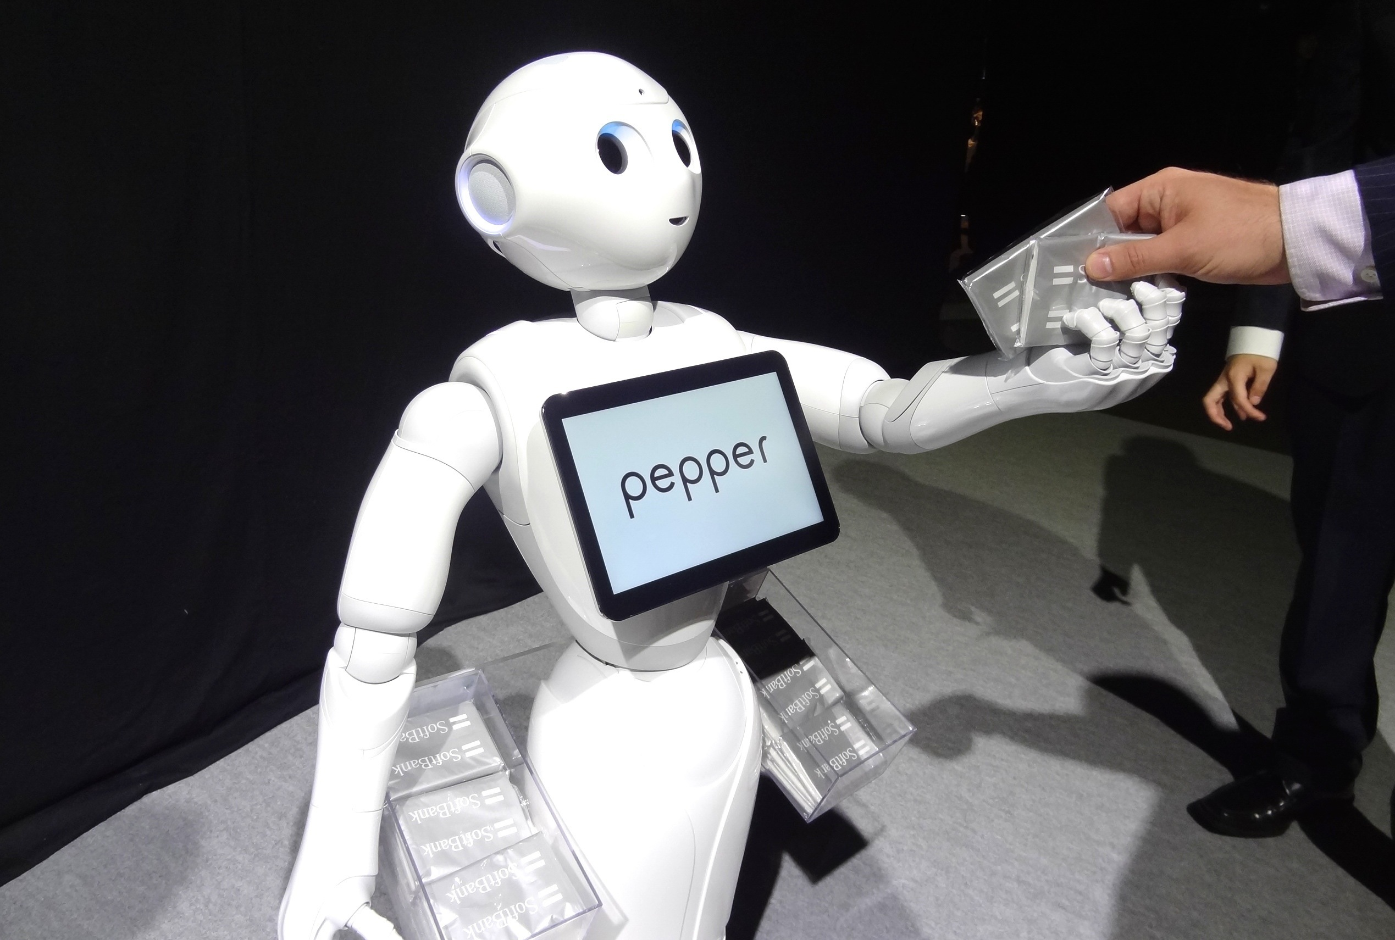
Goal
Hold a piece of paper in front of the Pepper robot,
and have it read the contents of the paper out loud.

Slide 3
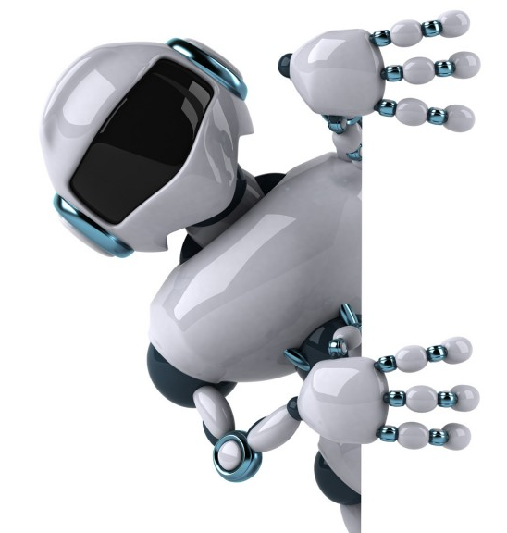
Motivation
More interaction with robots = expectations they can do basic tasks
Robots should be able to read signs, books, etc.
Methods already exist for image to text recognition, but lots of mistakes
Need high fidelity way to recognize text

Slide 4
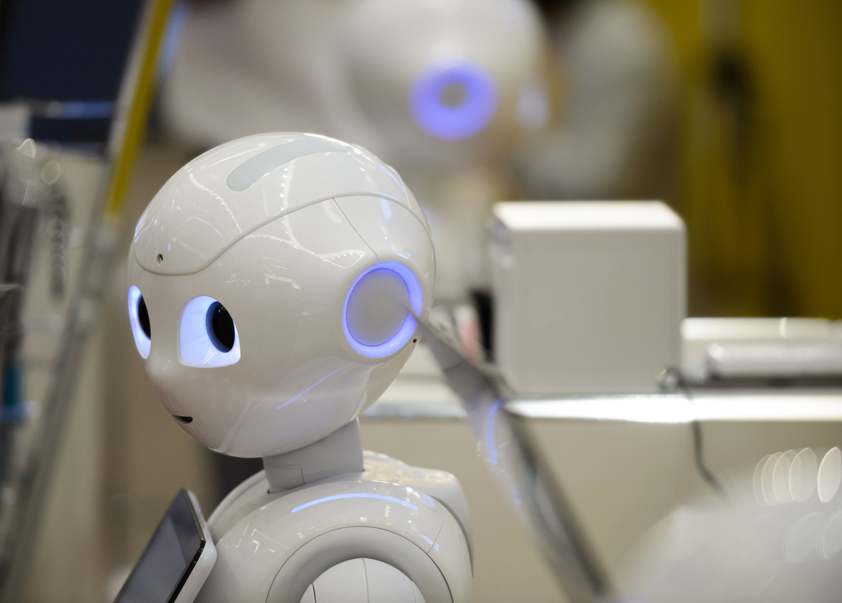




Motivation
Even more important to have high fidelity when you want to translate the image to text, and the text to speech
We use a strict method that requires the specific font to be known ahead of time.

Slide 5
Steps
Give program a standardized training file to recognize a font
Crop out each letter to make template
Take picture of text, transform and scale
Put each letter in “read” order
Use the templates to match to each letter
Use text to speech to read it out loud

Slide 6
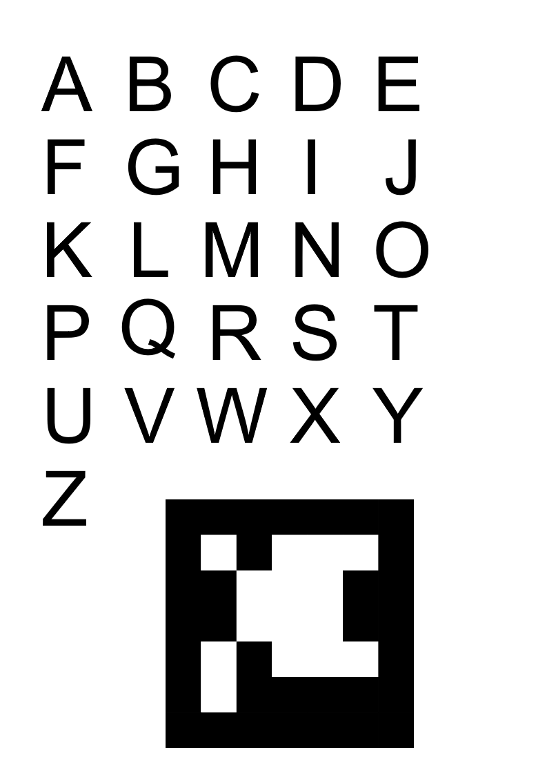
Training

Slide 7
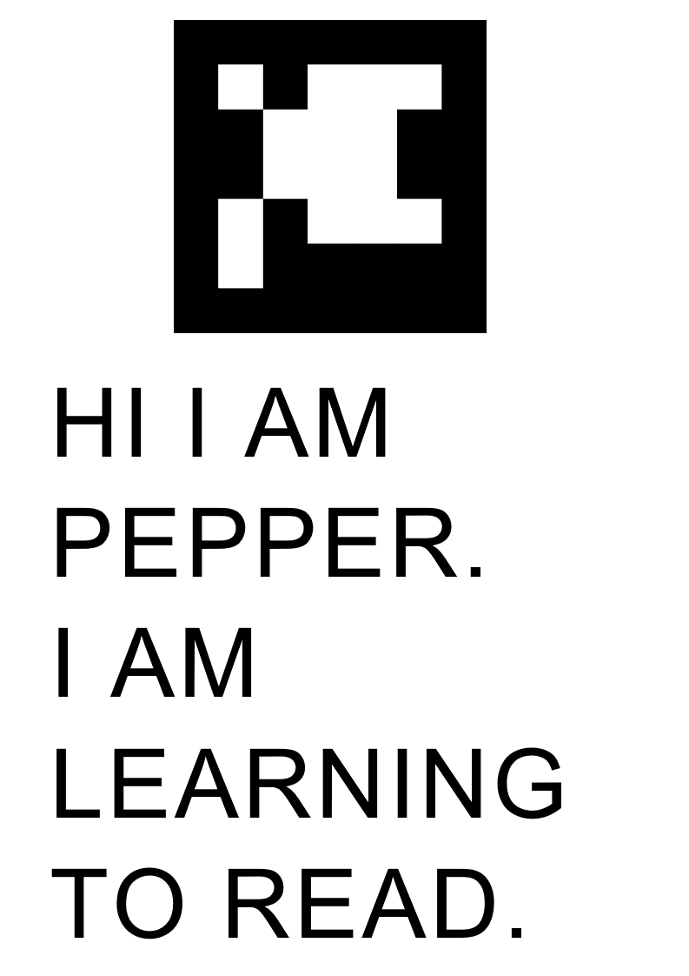
Input

Slide 8
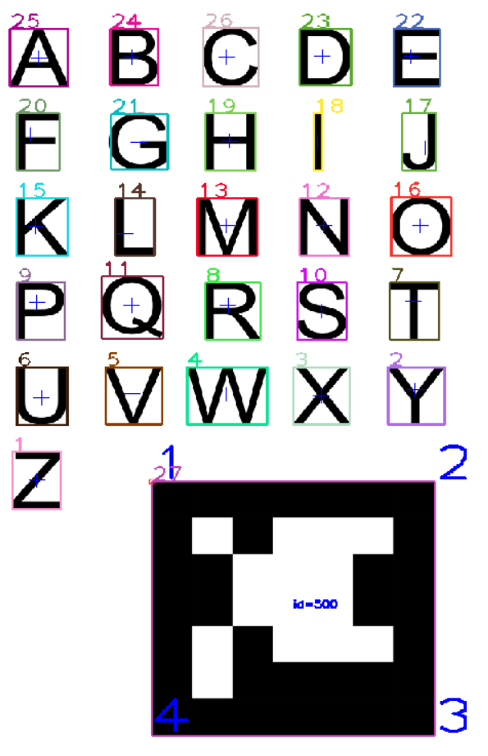
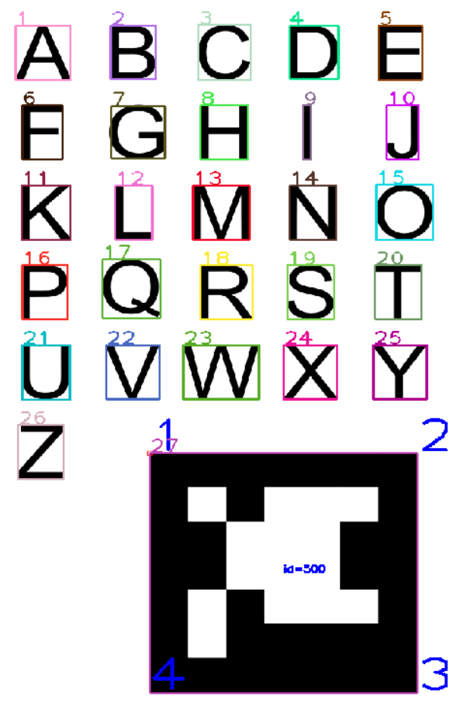

Automatic processing
Sort

Slide 9
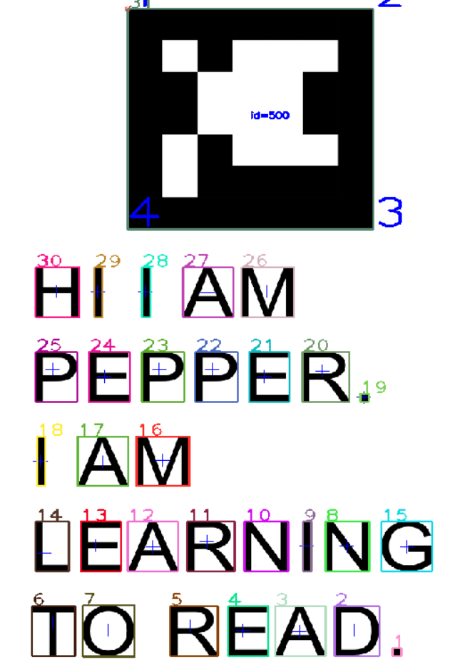
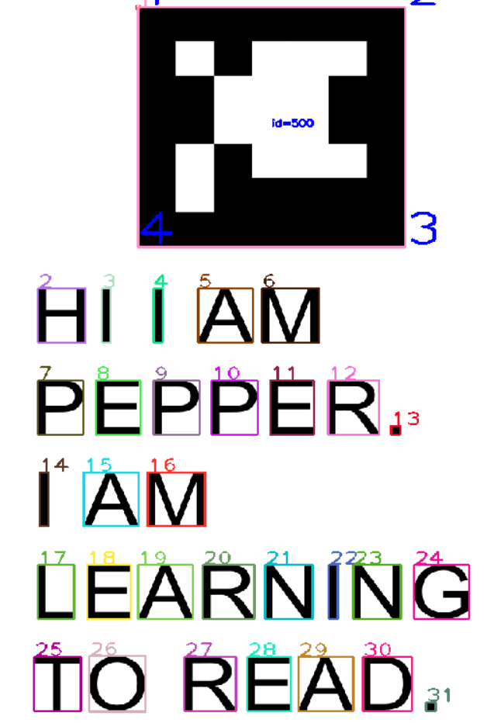
Input
Sort

Slide 10
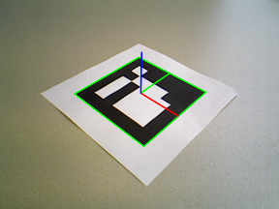
Aruco marker
Easy way to scale and transform text
Template matching requires perfect scale, rotation, no warping
Will use corners of aruco marker, and known size, to correct photo of text

Slide 11
Template matching

